Slide 1
Bike Sharing Demand Analysis
Presented by-karan
Organization-Nexthikes IT Solution

Slide 2
Overview
Analyzed bike sharing rental data using Excel to identify customer demand pattern based.
Imported and merged multiple dataset using common keys such as instant, dteday and hr with the help of power Query and lookup function.
Performed data cleaning by handling missing values, removing duplicates, and correcting data types.
Used Excel function like Sum, Average, IF, VLOOKUP, COUNTIF, and conditional formatting for data analysis.
Created pivot table, Pivot charts and interactive dashboard with slicer to visualize rental trends and business insights.

Slide 3
Hourly Rental Demand
Peak rental demand occurs during late morning to early evening- highest average rental are seen at hour 14(60.84) and hour 6(59.19),with another surge at hour 12(54.55).
Lowest rental happen in early morning hour-from hour 0 to 5 , average rental stays below 20, with the minimum at hour 2 (10.98) and hour 3(11.62).
Registered user follow a similar pattern-their average count rise during high rental hours.
Total rental spikes dramatically at hour 12-reaching 35,748 ,which suggest either an anomaly or a major event otherwise ,total rental remain between 300-3000 for the most hours.

Slide 4
Weekdays vs Weekends
Weekends see higher average -48.53 on weekends vs.33.99 on weekdays, indicating increasing demand.
Total sales nearly double on weekends-44,403 compared to 23,661 on weekdays.
Both casual and registered users increase on weekends – casual users rise from 30.12 to 44.10, registered from 3.87 to 4.43.
Overall averages confirm weekend preference – overall average is 42.25, total demand 68,064, driven largely by weekend usage.

Slide 5
Day period Demand
Afternoon and evening- have the highest average rental (52.52 and 51.72) and highest registered users (47.44 and 46.91).
Morning and night - show much lower average rental (25.63 and 26.06) and registered users (22.83 and 23.12).
Total sales - are highest in the afternoon (41,125), followed by morning (12,354), evening (11,223), and lowest at night (3,362).
Casual users - remain low across all shifts, but slightly higher in afternoon and evening (~5.0–4.8) compared to morning and night (~2.8–2.9).

Slide 6
Temperature effect registered vs casual
At low temperatures (0.02–0.16) -both casual and registered users are low – casual stays around 2–3, registered between 13–29.
As temperature rises (0.18–0.30)-both user types increase – casual reaches up to 8.76, registered peaks at 48.59.
At moderate-high temperature (0.34)- a sharp spike occurs – casual jumps to 20.55 and registered soars to 82.15, the highest in the data.
Registered users consistently outnumber -casual users across all temperatures, and their growth with temperature is much steeper, especially after 0.30.

Slide 7
Weather impact on rentals
Clear weather - gives the highest average rental (35.13) and total rental (21,288).
Light snow/rain - reduces average rental to 16, and heavy rain/snow further lowers it to 14.
Misty conditions -have the lowest impact – average rental drops sharply to just 2.51.
Casual users dominate - in clear weather (30.72 vs. 4.41 registered), showing weather affects casual riders much more than registered ones.

Slide 8
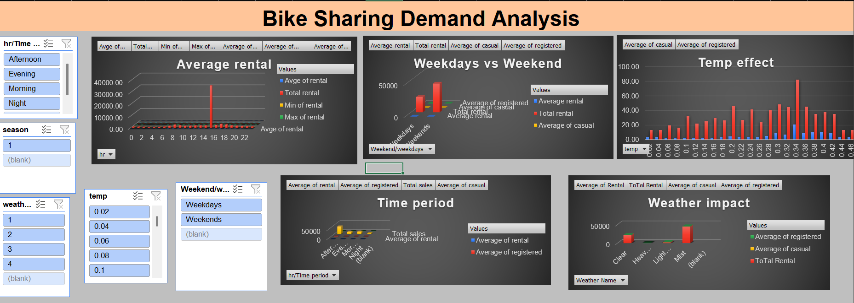
Dashboard

Slide 9
Overall Insights & Recommendations
Key insights
Recommendation
Peak rental hour are 8 am and 5-6 pm indicate commuter usage pattern.
Clear weather condition generate highest demand .
Registered user account for 76% of all rental.
Weekend rental show different pattern with mid-day peak.
Temperature significantly impacts demand – optimal range is 15-25c.
Launch a 5–7 AM "Morning Boost" discount to shift demand from peak hour 6·
Move bikes to storage on misty days (rental drops to 2.5) to reduce idle fleet cost·
Introduce a Weekend Midday Pass (10 AM–4 PM) for casual leisure riders·
Deploy pop-up kiosks near parks when temperature exceeds 0.30 (casual users double)·
Schedule maintenance during hour 3–4 (lowest demand: <12 avg rental)·
Turn hour 12’s 35,748 rental spike into a weekly "Noon Rush" flash sale

Slide 10
Thank you

